Slide 1
Example
Create an abstract class 'Parent' with a method 'message'. It has two subclasses each having a method with the same name 'message' that prints "This is first subclass" and "This is second subclass" respectively. Call the methods 'message' by creating an object for each subclass.
Create an abstract class 'Bank' with an abstract method 'getBalance'. $100, $150 and $200 are deposited in banks A, B and C respectively. 'BankA', 'BankB' and 'BankC' are subclasses of class 'Bank', each having a method named 'getBalance'. Call this method by creating an object of each of the three classes.
An abstract class has a construtor which prints "This is constructor of abstract class", an abstract method named 'a_method' and a non-abstract method which prints "This is a normal method of abstract class". A class 'SubClass' inherits the abstract class and has a method named 'a_method' which prints "This is abstract method". Now create an object of 'SubClass' and call the abstract method and the non-abstract method. (Analyse the result)

Slide 2
Exercise # 4
In this task, you have to calculate the percentage of marks obtained in three subjects (each out of 100) by student A and in four subjects (each out of 100) by student B. Create an abstract class 'Marks' with an abstract method 'getPercentage'. It is inherited by two other classes 'A' and 'B' each having a method with the same name which returns the percentage of the students. The constructor of student A takes the marks in three subjects as its parameters and the marks in four subjects as its parameters for student B. Create an object for each of the two classes and print the percentage of marks for both the students.

Slide 3
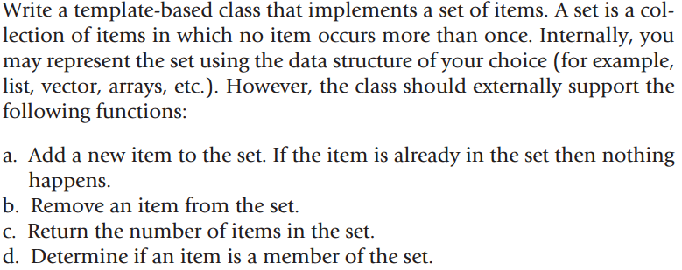
Exercise # 5

Slide 4
Week Eleven– Class Two

Slide 5
Introduction to filing
Files are used to store data in a storage device permanently.
File handling provides a mechanism to store the output of a program in a file and to perform various operations on it.
A stream is an abstraction that represents a device on which operations of input and output are performed.

Slide 6
Introduction to filing
ASCII Text file
A text file can be a stream of characters that a computer can process sequentially. I
Binary file
A binary file is no different to a text file but it is a collection of bytes rather than characters.

Slide 7
Streams
Stream
A transfer of information in the form of a sequence of bytes
I/O Operations
Input: A stream that flows from an input device ( i.e.: keyboard, disk drive, network connection) to main memory
Output: A stream that flows from main memory to an output device ( i.e.: screen, printer, disk drive, network connection)

Slide 8
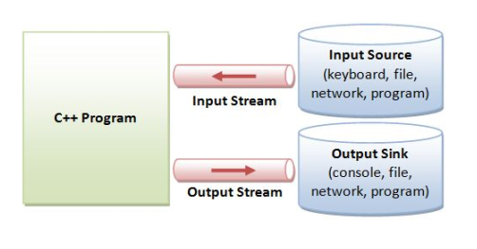

Slide 9
Iostream Library Header Files
<iostream.h>: Contains cin & cout objects

Slide 10
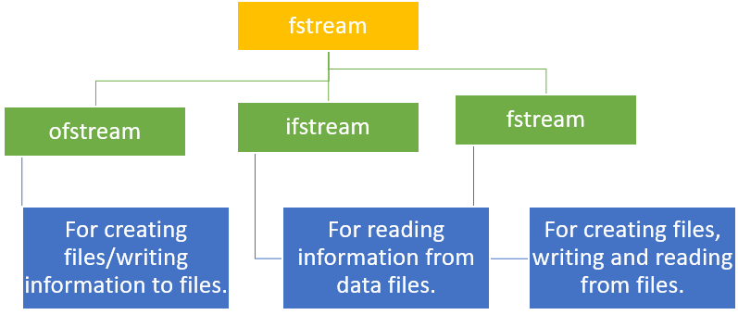
File handling Classes
These includes:
ofstream: This Stream class signifies the output file stream and is applied to create files for writing information to files
ifstream: This Stream class signifies the input file stream and is applied for reading information from files
fstream: This Stream class can be used for both read and write from/to files

Slide 11
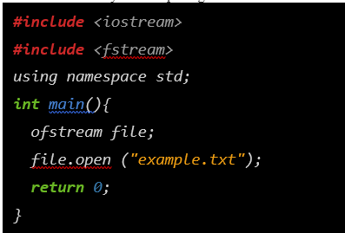
Opening a File
We can open a file using any one of the following methods:
First is bypassing the file name in constructor at the time of object creation.
Second is using the open() function.
Ofstream are used to create and write the file
Open() function open your file
File.open(“example.txt”,ios::out)
The second argument represents the mode in which the file has to be opened

Slide 12
Opening Files Mode
1 | ios::app Append mode. All output to that file to be appended to the end.
2 | ios::ate Open a file for output and move the read/write control to the end of the file.
3 | ios::in Open a file for reading.
4 | ios::out Open a file for writing. . . .

Slide 13
File Processing Function
open(): To create a file
close(): To close an existing file
get(): to read a single character from the file
put(): to write a single character in the file
read(): to read data from a file
write(): to write data into a file

Slide 14
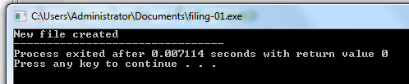

Opening File- Example
#include<iostream>
#include <fstream>
using namespace std;
int main()
{
fstream new_file;
new_file.open("new_file",ios::out);
if(!new_file)
{
cout<<"File creation failed";
}
else
{
cout<<"New file created";
new_file.close(); // Step 4: Closing file
}
return 0;}

Slide 15
Open()
Opening a file associates a file stream variable declared in the program with a physical file at the source, such as a disk.
In the case of an input file:
the file must exist before the open statement executes.
If the file does not exist, the open statement fails and the input stream enters the fail state
An output file does not have to exist before it is opened;
if the output file does not exist, the computer prepares an empty file for output.
If the designated output file already exists, by default, the old contents are erased when the file is opened.

Slide 16
Validate the file before trying to access
Method 1:
By checking the stream variable;
If ( ! Mystream)
{
Cout << “Cannot open file.\n ”;
}
Method 2:
By using bool is_open() function.
If ( ! Mystream.is_open()) {
Cout << “File is not open.\n ”;
}

Slide 17
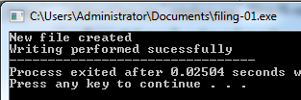
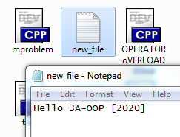
Writing File- Example
#include<iostream>
#include <fstream>
using namespace std;
int main(){
fstream new_file;
new_file.open("new_file",ios::out);
if(!new_file)
{
cout<<"File creation failed";
}
else
{
cout<<"New file created";
new_file<<" Hello 3A-OOP [2020]";
cout<<"Writing performed sucessfully";
new_file.close(); // Step 4: Closing file
}return 0;}

Slide 18
File I/O Example: Writing
First Method (use the constructor)
Second Method ( use Open function)
#include <fstream>
using namespace std;
int main()
{/* declare and automatically open the file*/
ofstream outFile("fout.txt");
//behave just like cout, put the word into the file
outFile << "Hello World!";
outFile.close();
return 0;
}
#include <fstream>
using namespace std;
int main(){// declare output file variable
ofstream outFile;
// open an exist file fout.txt
outFile.open("fout.txt”);
//behave just like cout, put the word into the file
outFile << "Hello World!";
outFile.close();
return 0;}

Slide 19
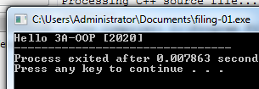
Reading File- Example
int main()
{
//Declare and open a text file
ifstream openFile("new_file.txt");
string line;
while(!openFile.eof())
{
//fetch line from data.txt and put it in a string
getline(openFile, line);
cout << line;
}
openFile.close(); // close the file
return 0; }

Slide 20
File I/O Example: Reading
Read char by char
Read a line
#include <iostream>
#include <fstream>
int main()
{//Declare and open a text file
ifstream openFile(“data.txt");
char ch;
//do until the end of file
while( ! OpenFile.eof() )
{
OpenFile.get(ch); // get one character
cout << ch; // display the character
}
OpenFile.close(); // close the file
return 0;
}
#include <iostream>
#include <fstream>
#include <string>
int main()
{//Declare and open a text file
ifstream openFile("data.txt");
string line;
while(!openFile.eof())
{//fetch line from data.txt and put it in a string
getline(openFile, line);
cout << line;
}
openFile.close(); // close the file
return 0; }

Slide 21
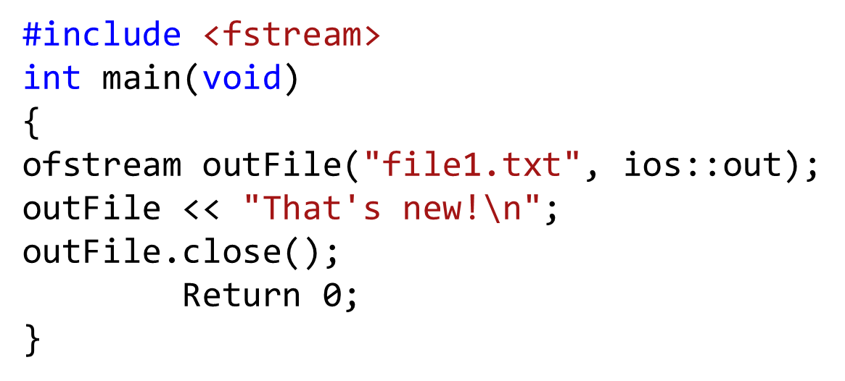
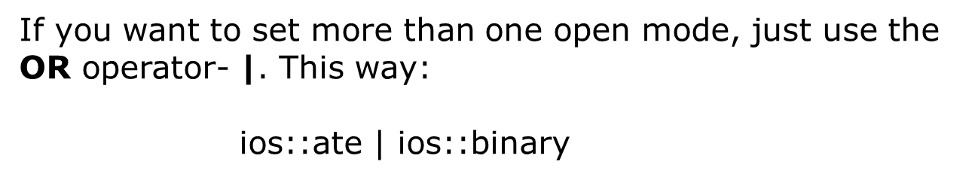
File Open Mode

Slide 22
File format
In c++ files we (read from/ write to) them as a stream of characters
What if I want to write or read numbers ?

Slide 23
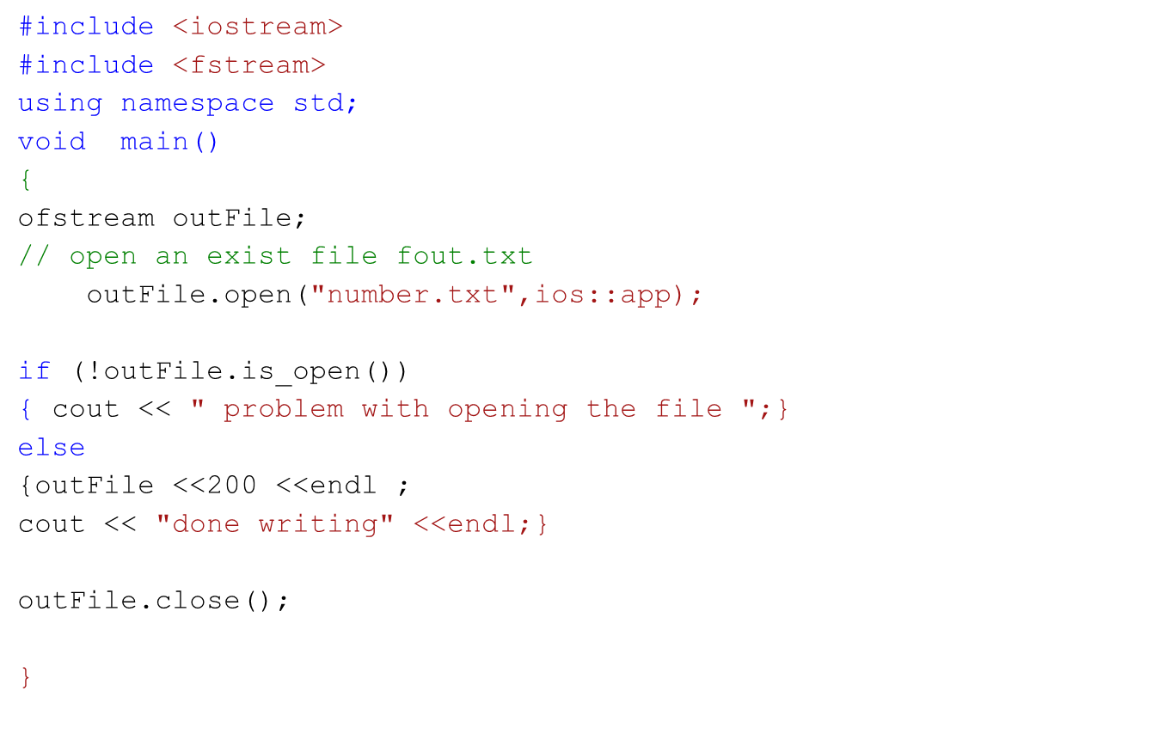
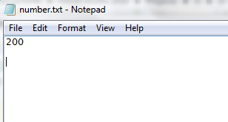
Example writing to file

Slide 24
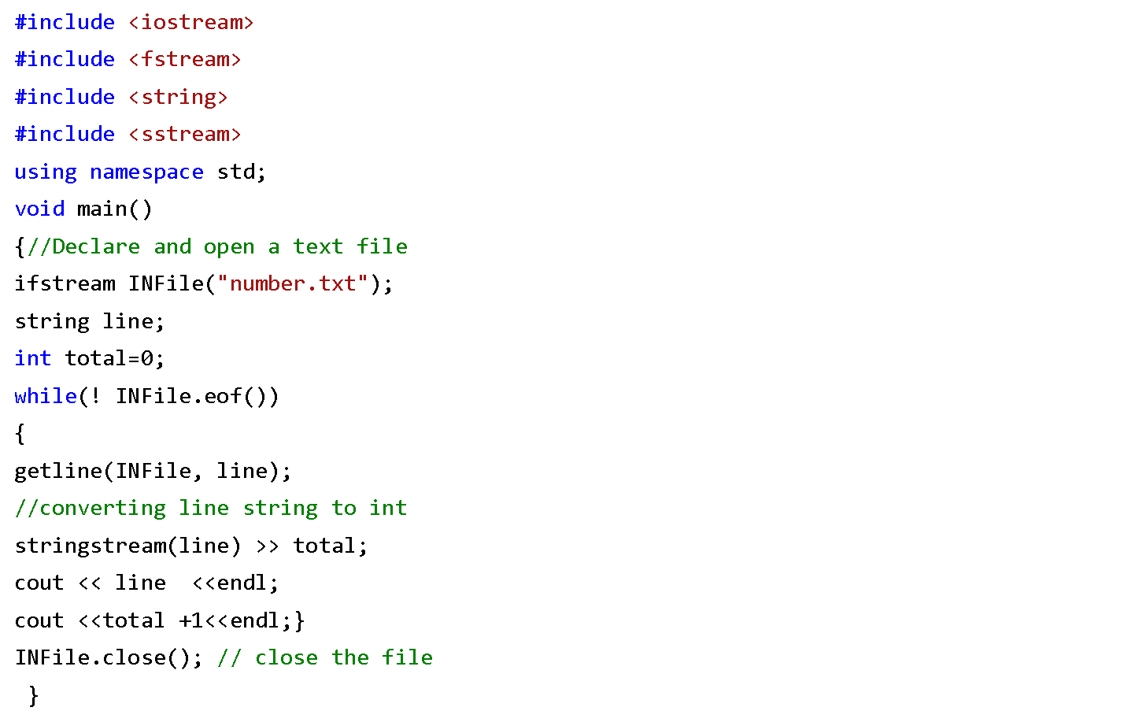
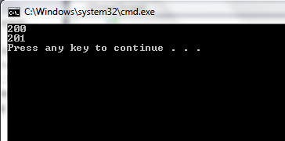
Example Reading from file

Slide 25

File-handling using OOP concept
Syntax of write() function
The write() function takes two arguments. &obj : Initial byte of an object stored in memory. sizeof(obj) : size of object represents the total number of bytes to be written from initial byte.

Slide 26

File-handling using OOP concept
Syntax of read() function
The read() function takes two arguments. &obj : Initial byte of an object stored in file. sizeof(obj) : size of object represents the total number of bytes to be read from initial byte.

Slide 27
Example
void AddRecord()
{
fstream f;
Student Stu;
f.open("Student.txt",ios::app|ios::binary);
Stu.getdata();
f.write( (char *) &Stu, sizeof(Stu) );
f.close();
}
void Display()
{
fstream f;
Student Stu;
f.open("Student.txt",ios::in|ios::binary);
cout<<"\n\tRoll\tName\tMarks\n";
while( (f.read((char*)&Stu,sizeof(Stu))) != NULL )
Stu.fetchdata();
f.close();
}};
#include <iostream>
#include <fstream>
#include <conio.h>
using namespace std;
class Student {
int roll;
char name[25];
float marks;
void getdata()
{
cout<<"\n\nEnter Roll : ";
cin>>roll;
cout<<"\nEnter Name : ";
cin>>name;
cout<<"\nEnter Marks : ";
cin>>marks;
}
void fetchdata()
{ cout<<"\n\t"<<roll<<"\t"<<name<<"\t"<<marks;}
public:

Slide 28
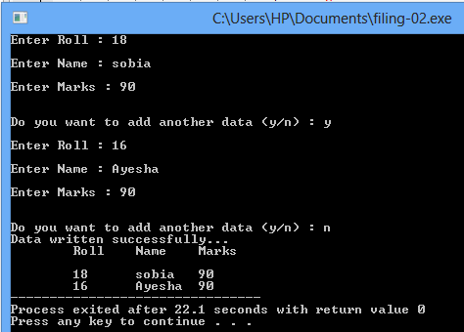
int main()
{
Student S;
char ch='n';
do
{
S.AddRecord();
cout<<"\n\nDo you want to add another data (y/n) : ";
ch = getche();
} while(ch=='y' || ch=='Y');
cout<<"\nData written successfully...";
S.Display();
}

